Slide 1
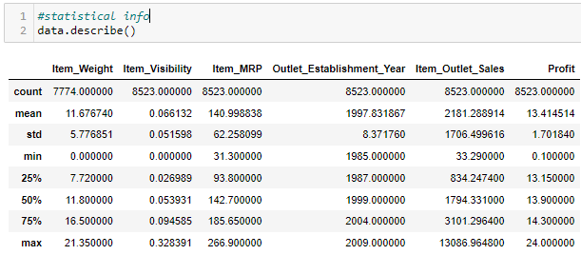
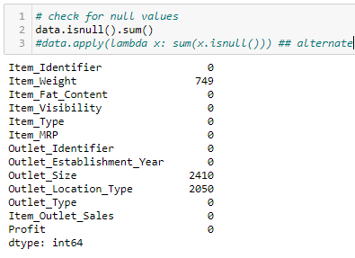
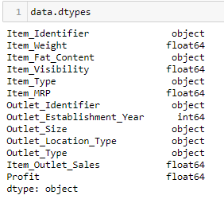

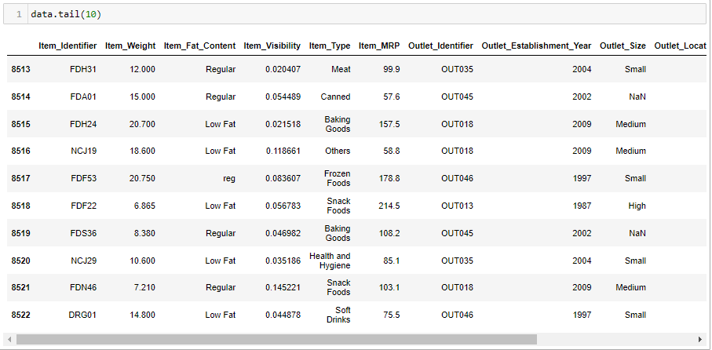
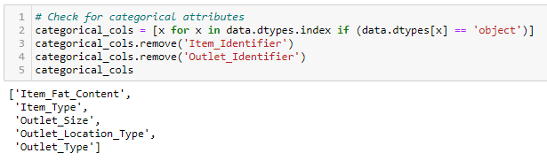

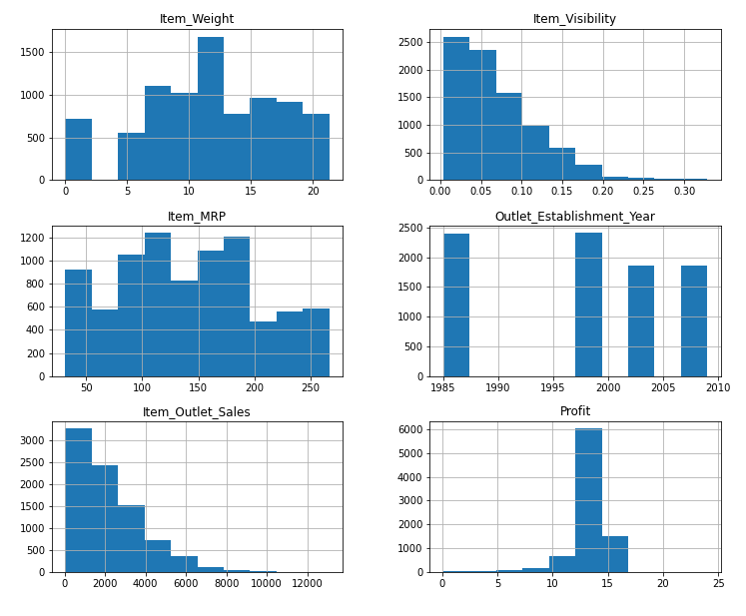
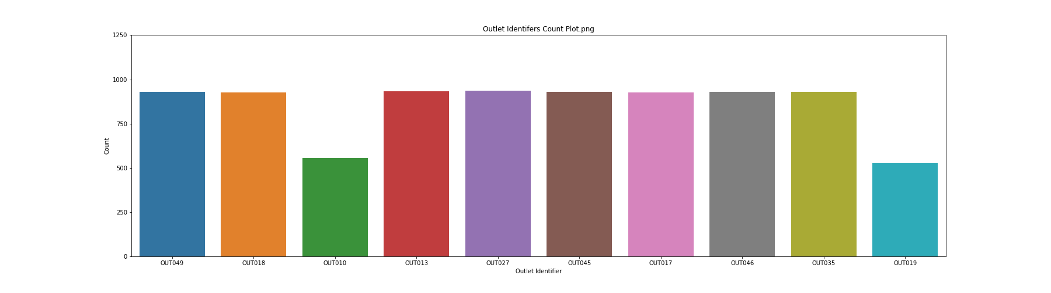
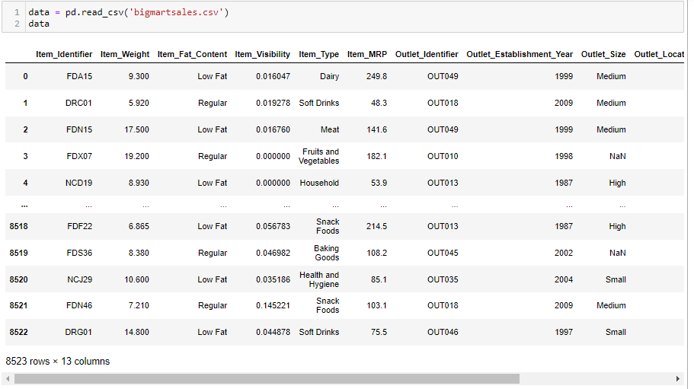

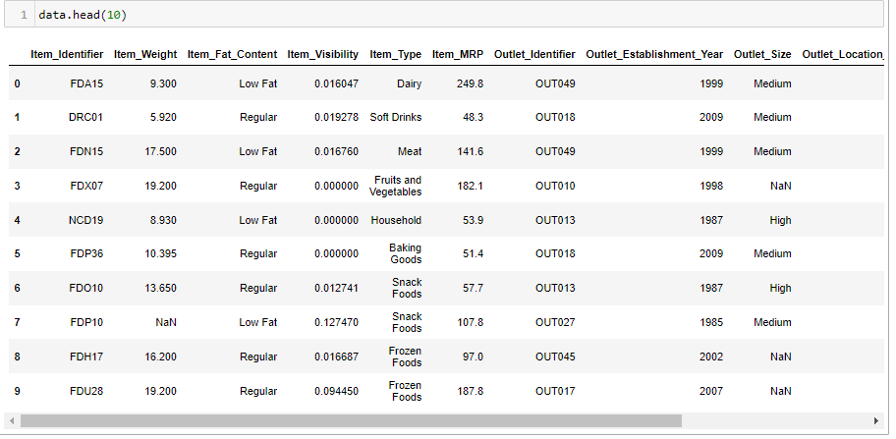

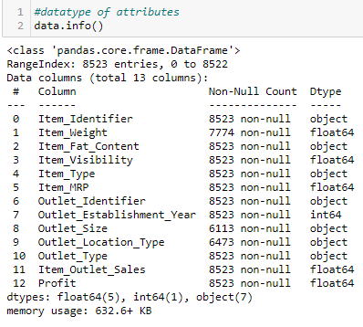

Here I have presented some of the data collected for your reference…
The Data Analytics team at BigMart have acquired sales data over a period from 1985 to 2009
Good Day Sirs and Madams

Slide 2
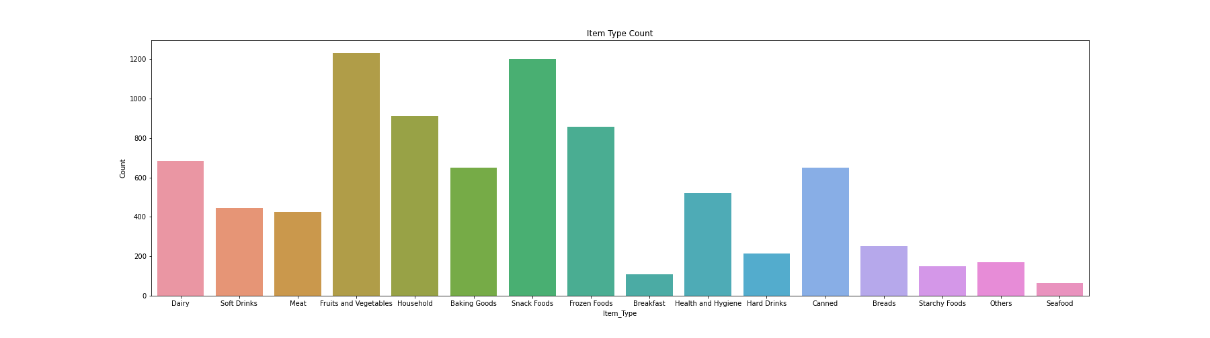
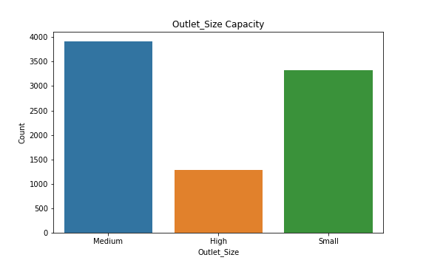
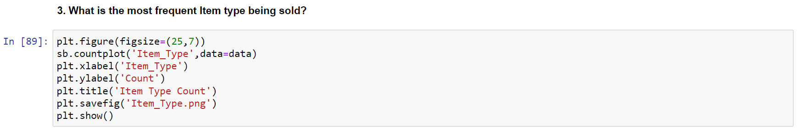
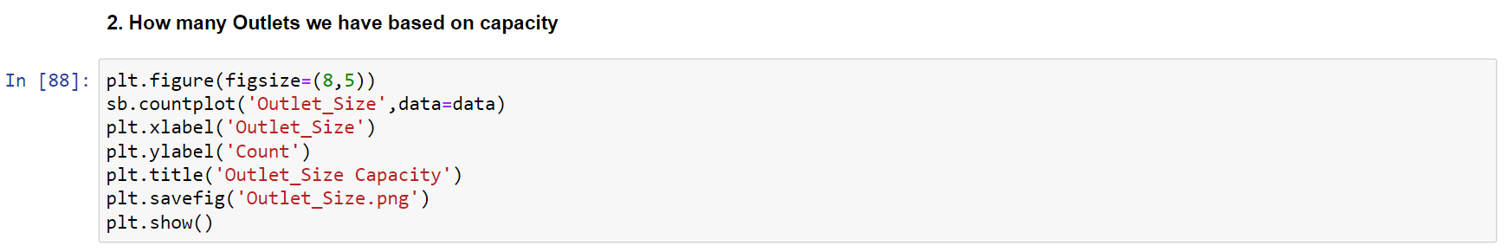
And what is the most frequent Item type being sold?
Here is the information for that.
Here we have the Outlet size based on it’s capacity
So, how many Outlets do we have based on capacity?
Give me a moment Sir. Let me retrieve the data for you

Slide 3
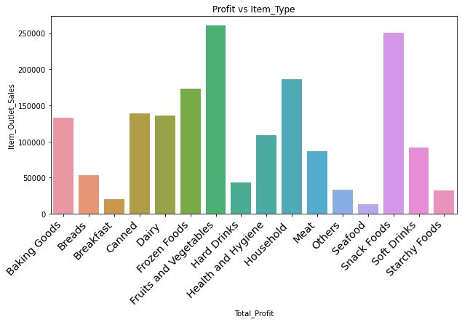
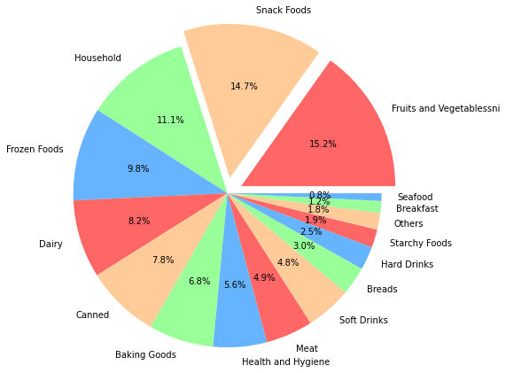
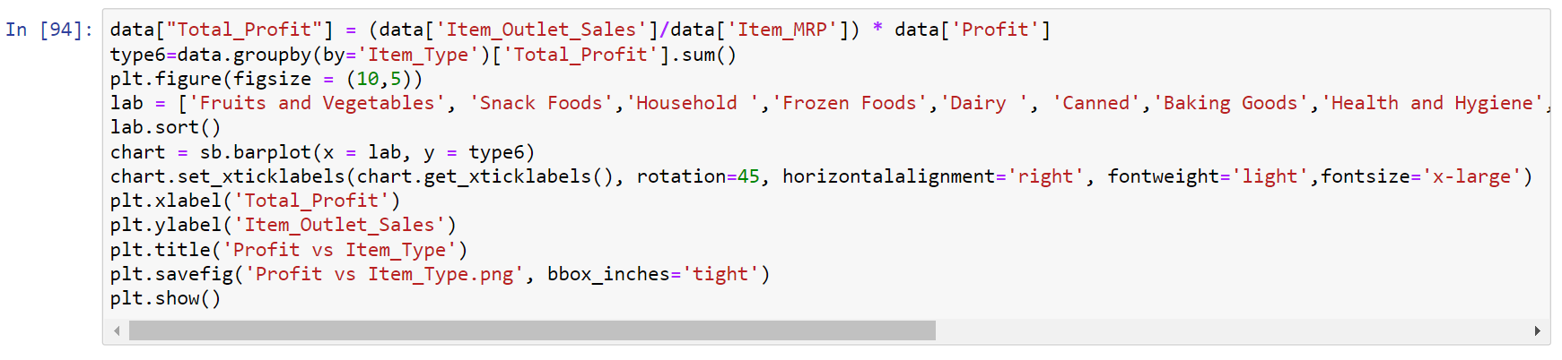
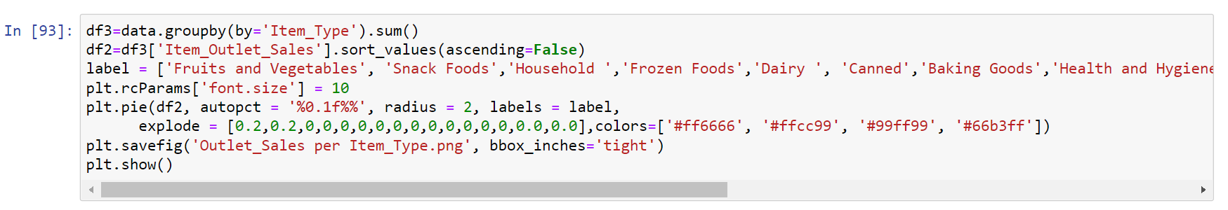
The Outlet sales per Item category is as follows…
The Profit for each type of Item can be viewed here.
How has the type of Item affected overall Profit?
What are the Outlet sales per Item category?

Slide 4
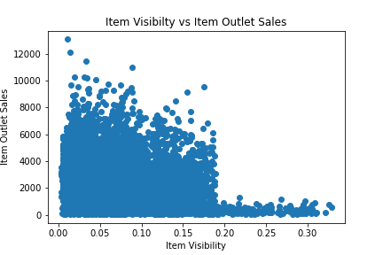
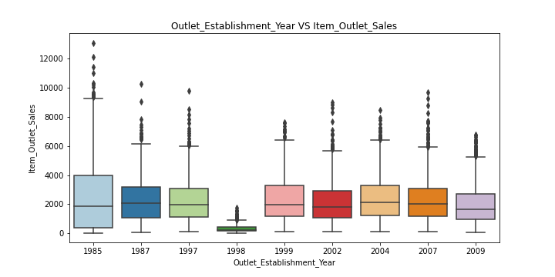
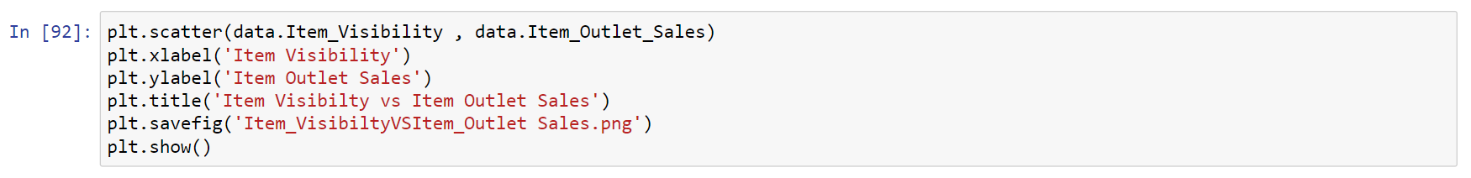
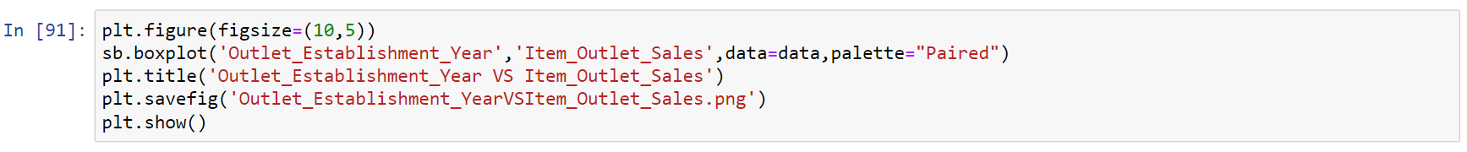
What is the impact of item visibility on item outlet sale?
The visibility of items impacting the outlet sale is as follows:
The profit variation over the period from 1985 to 2009 can be viewed on your screen.
How has the Sales varied over the years?

Slide 5
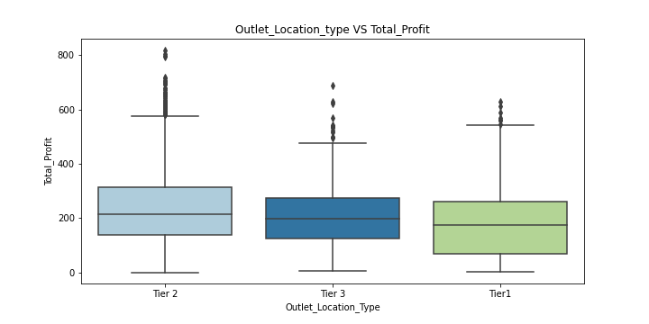
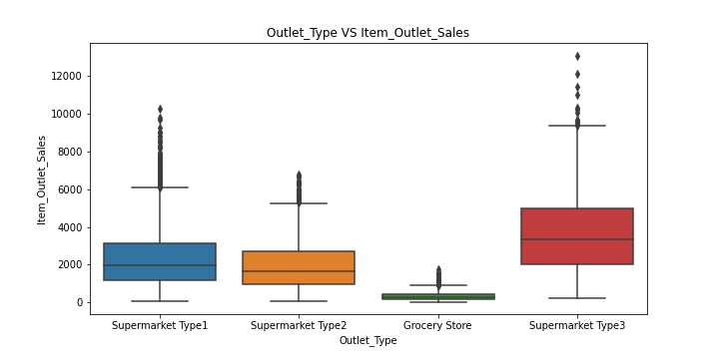
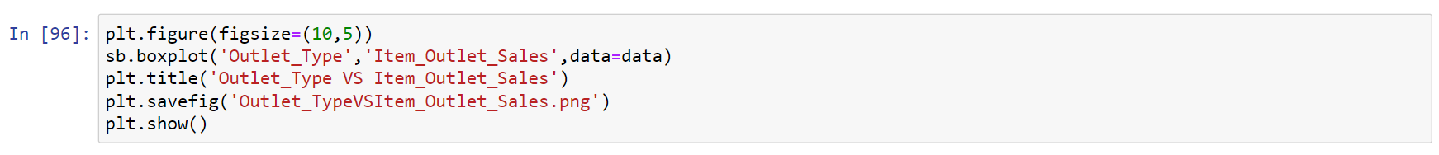
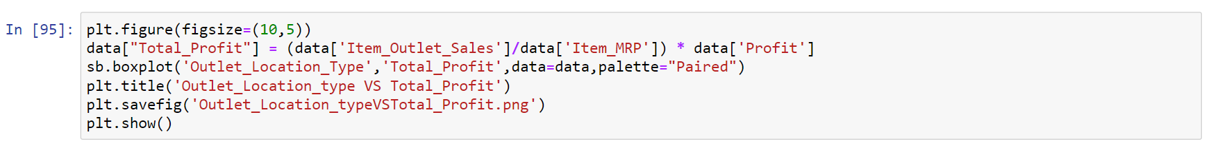
Thank you Sirs and Madam.
Thank you for the data and analysis that you have provided. This will help us in taking more appropriate business decisions in the next fiscal year
We can view the total profits earned through our different outlet locations in the following data
We have 4 different types of outlets and their sales per type of outlet can be viewed through this data
How are the sales per type of outlet?
What is the total profit over different outlet locations?

